Slide 1

UTA EE Lab Workshops
Raspberry Pi Touchscreen displays

Slide 2
PowerPoint and code
The PowerPoint, code and associated files can be found on our GitHub Page.
GitHub.com/EELabMan - > Repositories - > Rpi-Touch-Display

Slide 3
The Datasheet and Pi software configuration
http://www.lcdwiki.com/MHS-3.5inch_RPi_Display
Physical resolution 320 x 480, with resistive touch control
It supports up to 125MHz SPI signal input, showing stable no screen and no flicker
Same size as the Raspberry Pi, perfectly compatible and can be directly inserted into any version of the Raspberry Pi (Raspberry Pi ZeroW, A, A+, B, B+, 2B, 3B, 3B+,4B)
Support Raspbian/Ubuntu/Kali system, provide driver and image
Name | Description
SKU | MHS3528
Screen Size | 3.5inch
LCD Type | TFT
Module Interface | SPI (upports up to 125MHz SPI input)
Resolution | 320*480 (Pixel)
Touch Screen Controller | XPT2046
LCD Driver IC | ILI9486
Backlight | LED
power consumption | 0.16A*5V
Working temperature（℃） | -20~60
Active Area | 48.96x73.44(mm)
Module PCB Size | 85.42*55.60 (mm)
Package Size | 136x98x41 (mm)
Product Weight(Package containing)(g) | 92 (g)

Slide 4
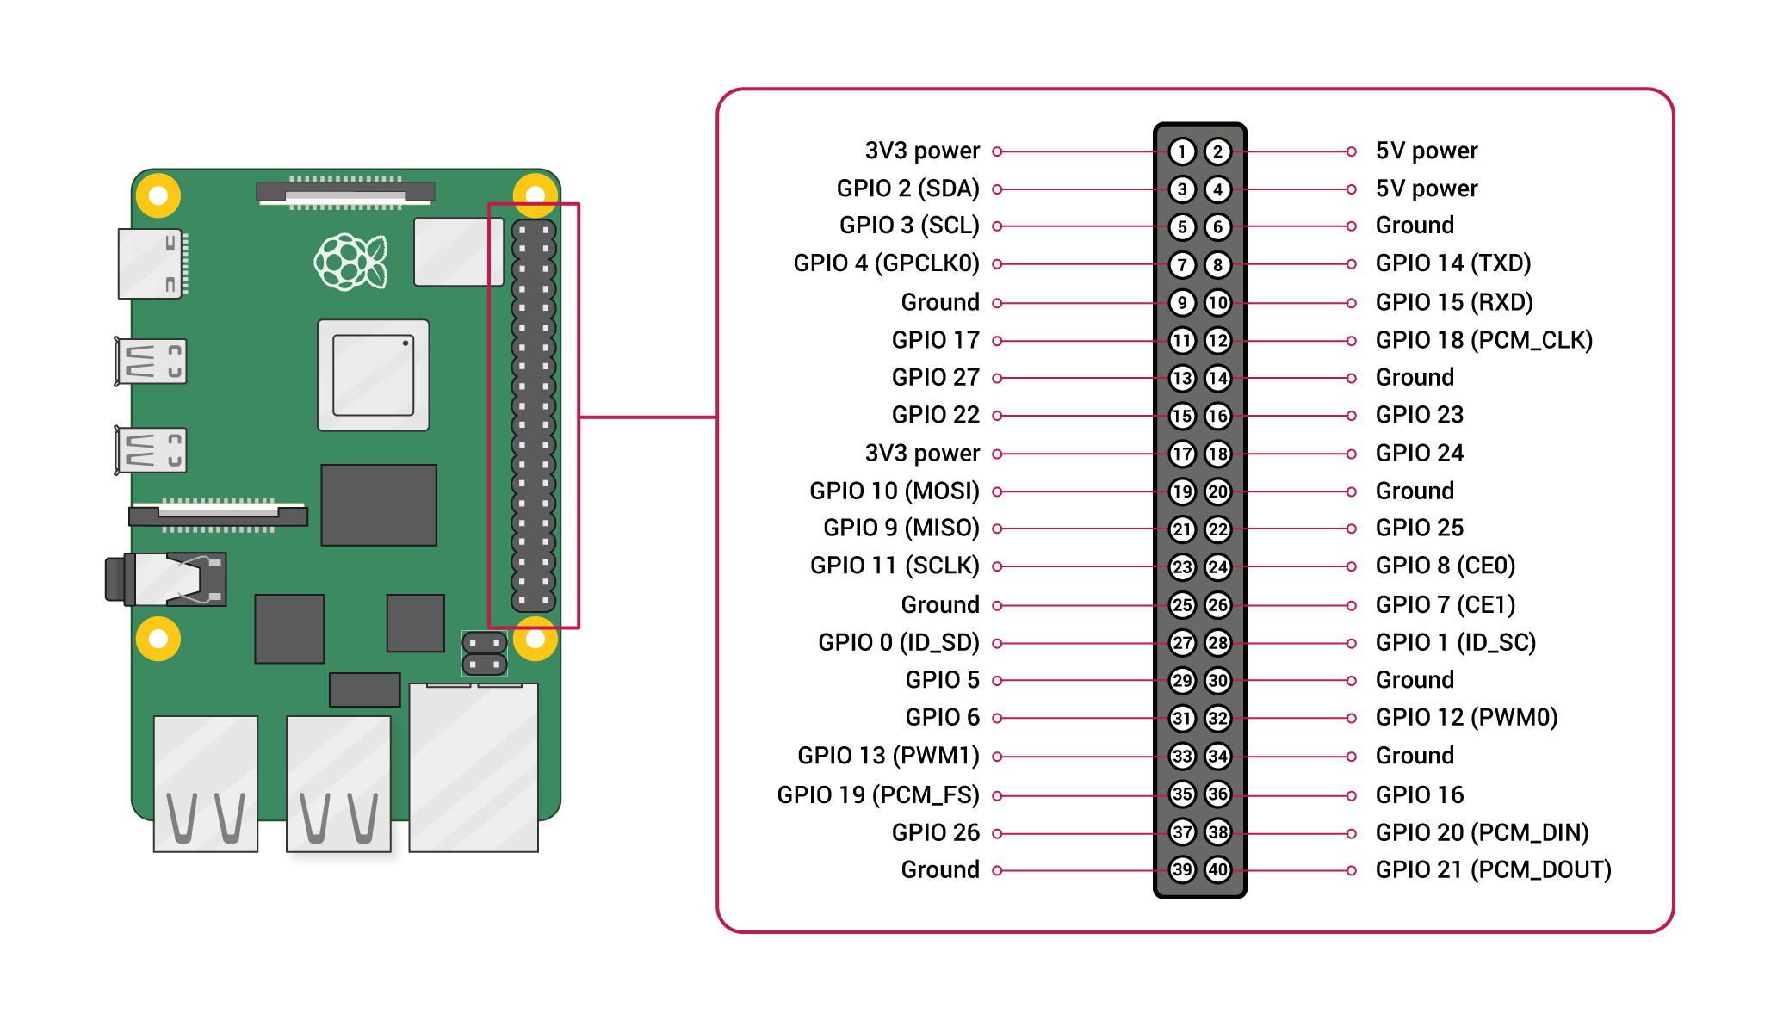
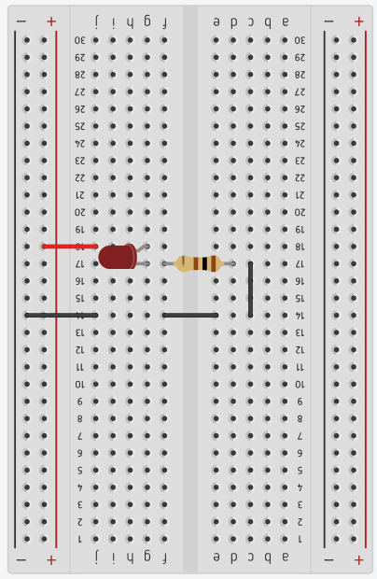
Add LED
100Ω

Slide 5
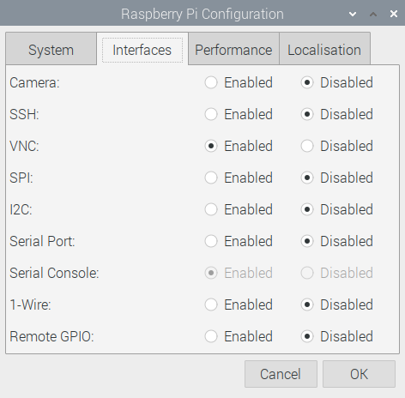
Power on the Pi
Plug in a SD Card, monitor, keyboard, mouse and ethernet cable.
Plug in the power to turn on the Pi.
Check if VNC is running in the upper right corner.
If it is, click it to get the IP address of the raspberry Pi.
If not, Click the “Raspberry” ->Preferences-> Raspberry Pi Configuration.
Select the Interfaces tab and enable VNC.
ALSO - enable SSH and SPI BUS
Turn off the Pi.
Unplug the Monitor, keyboard and mouse and power on again.

Slide 6
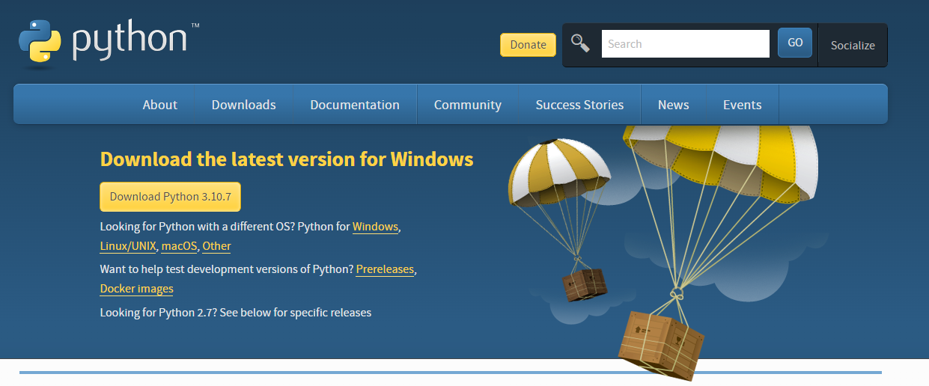
Let’s download Python onto our laptops
https://www.python.org/downloads/

Slide 7
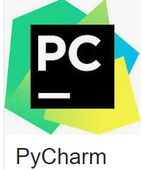
We can develop the Python code on our laptops and transfer it to the Raspberry Pi later.
Make Sure you download the COMMUNITYY EDITION – This is Free!
We will use this free Python IDE to create our python programs.
https://www.jetbrains.com/pycharm/download

Slide 8
Let’s code Python with TKinter
What we will do is very basic. I highly recommend the YouTube series on Tkinter by “The New Boston”. https://www.youtube.com/watch?v=RJB1Ek2Ko_Y&list=PL6gx4Cwl9DGBwibXFtPtflztSNPGuIB_d
Open a new project in Pycharm and type the following code.
Right click the code area and select run.
from tkinter import * root = Tk() theLabel= Label(root, text="Are we having fun yet?") theLabel.pack() root.mainloop()

Slide 9
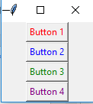
Let's put some buttons on that
from tkinter import * root = Tk() topFrame = Frame(root) topFrame.pack() bottomFrame = Frame(root) bottomFrame.pack(side=BOTTOM) button1 = Button(topFrame, text="Button 1", fg="red") button2 = Button(topFrame, text="Button 2", fg="blue") button3 = Button(topFrame, text="Button 3", fg="green") button4 = Button(bottomFrame, text="Button 4", fg="purple") button1.pack() button2.pack() button3.pack() button4.pack() root.mainloop()
Right click and select run when entered

Slide 10

Let's arrange these buttons
from tkinter import * root = Tk() topFrame = Frame(root) topFrame.pack() bottomFrame = Frame(root) bottomFrame.pack(side=BOTTOM) button1 = Button(topFrame, text="Button 1", fg="red") button2 = Button(topFrame, text="Button 2", fg="blue") button3 = Button(topFrame, text="Button 3", fg="green") button4 = Button(bottomFrame, text="Button 4", fg="purple") button1.pack(side=LEFT) button2.pack(side=LEFT) button3.pack(side=LEFT) button4.pack(side=BOTTOM) root.mainloop()

Slide 11
Using grid
from tkinter import * root = Tk() root.title("My Application") label_1 = Label(root, text="Name") label_2 = Label(root, text="Password") entry_1 = Entry(root) entry_2 = Entry(root) label_1.grid(row=0, sticky=W) label_2.grid(row=1) entry_1.grid(row=0, column = 1) entry_2.grid(row=1, column = 1) c = Checkbutton(root, text="Keep me logged in") c.grid(columnspan=2) root.mainloop()
Enter this and run it to see how grid organizes the UI
Notes:
grid is considerably easier to use if you need to lay things out in a grid. pack is generally easier to use if all you need to do is put some widgets in a single row or single column. There's a whole lot of gray area in-between where neither is necessarily better than the other.
The other thing to consider is what you said in your question: if you want to show and hide widgets at run-time, grid is probably the best choice because of the grid_remove method which remembers the values of all of the configured attributes in case you want to re-add the widget.

Slide 12
Button Function
Binding a function to a widget
from tkinter import * root = Tk() def printName(): print("Type your name here") button_1 = Button(root, text="Print name to console", command=printName()) button_1.pack() root.mainloop()

Slide 13
Button Function
Modify the code like this
from tkinter import * root = Tk() def printName(event): print("Type your name here") button_1 = Button(root, text="Print name to console") button_1.bind("<Button-1>", printName) button_1.pack() root.mainloop()

Slide 14
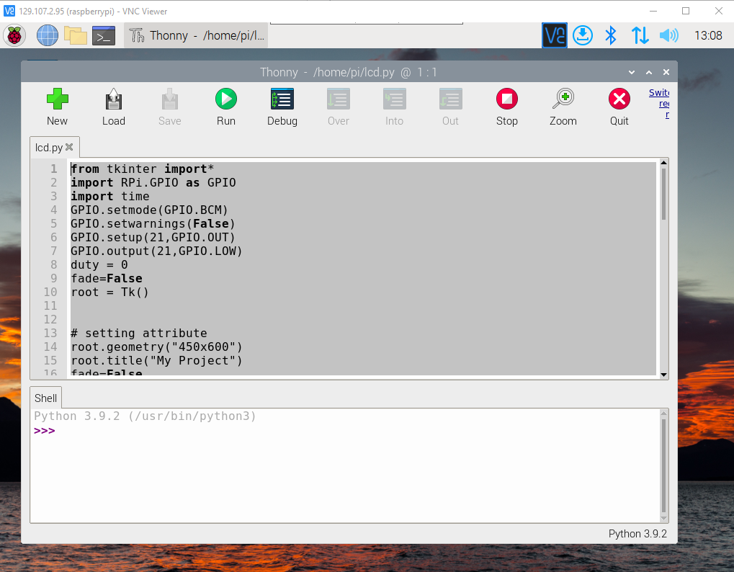
Open Thonny and download lcd.py form GitHub

Slide 15
How to stop a Program on Raspberry Pi
Open a new terminal window and type the following command: top.
Find the process ID (under column PID) for the program you want to kill.
Press CTRL C to exit top.
Type the following command to end the program: sudo kill -9 process_ID.

Slide 16
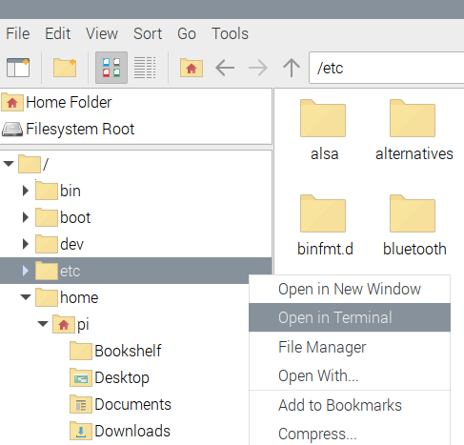
How to auto Start a program in Raspberry PI OS / Linux
Open File Explorer and right click on etc folder and select Open in Terminal.
Type sudo nano ~/.bashrc
Scroll to the very bottom and insert “sudo python3 /home/pi/Desktop/lcd.py
Ctrl +x save changes
Type source ~/.bashrc to test.

Slide 17
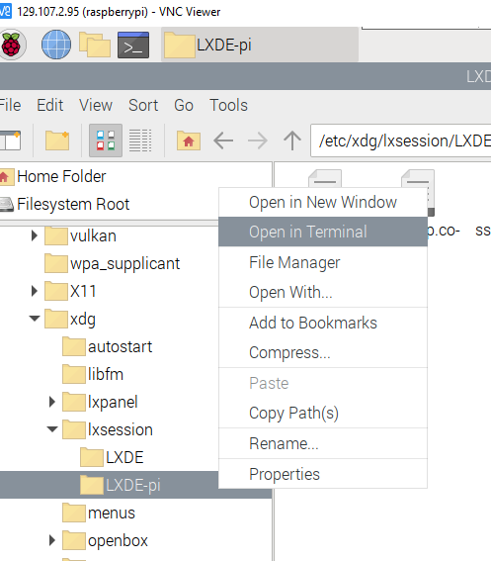
How to auto Start a program in Raspberry PI OS / Linux
Close the lcd.py program
Now we need to open a terminal window upon reboot.
Go to etc/xdg/lxsession/LXDE-pi and open the terminal
Close the lcd.py program again
Type sudo nano autostart
Scroll to the very bottom and add the line
@lxterminal
Ctrl +x , y to save

Slide 18
Install drivers for touch screen
Open the Terminal Window and enter the code one line at a time.
The pi will reboot, and you may lose your display. Hit the windows (pi) key, press up and enter twice to shut down the pi. Wait until the green LED stops blinking.
Remove the Display , Keyboard and Mouse. They interfere with the small display.
sudo apt-get update
sudo rm -rf LCD-show
git clone https://github.com/goodtft/LCD-show.git
chmod -R 755 LCD-show
cd LCD-show/
sudo ./LCD35-show 90

Slide 19
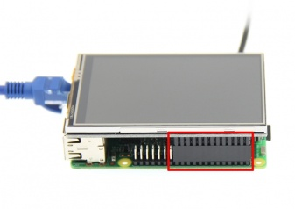
Install the Display
PIN NO. | SYMBOL | DESCRIPTION
1, 17 | 3.3V | Power positive (3.3V power input)
2, 4 | 5V | Power positive (5V power input)
3, 5, 7, 8, 10, 12, 13, 15, 16 | NC | NC
6, 9, 14, 20, 25 | GND | Power ground
11 | TP_IRQ | The touch panel is interrupted, and it is detected that the touch panel is pressed low
18 | LCD_RS | Instruction/data register selection, low level is instruction, high level is data
19 | LCD_SI / TP_SI | LCD display / touch panel SPI data input
21 | TP_SO | Touch panel SPI data output
22 | RST | Reset signal, low reset
23 | LCD_SCK / TP_SCK | LCD display / touch panel SPI clock signal
24 | LCD_CS | LCD chip select signal, low level enable
26 | TP_CS | Touch panel chip select signal, low level enable
Align right-side to insert the LCD screen

Slide 20
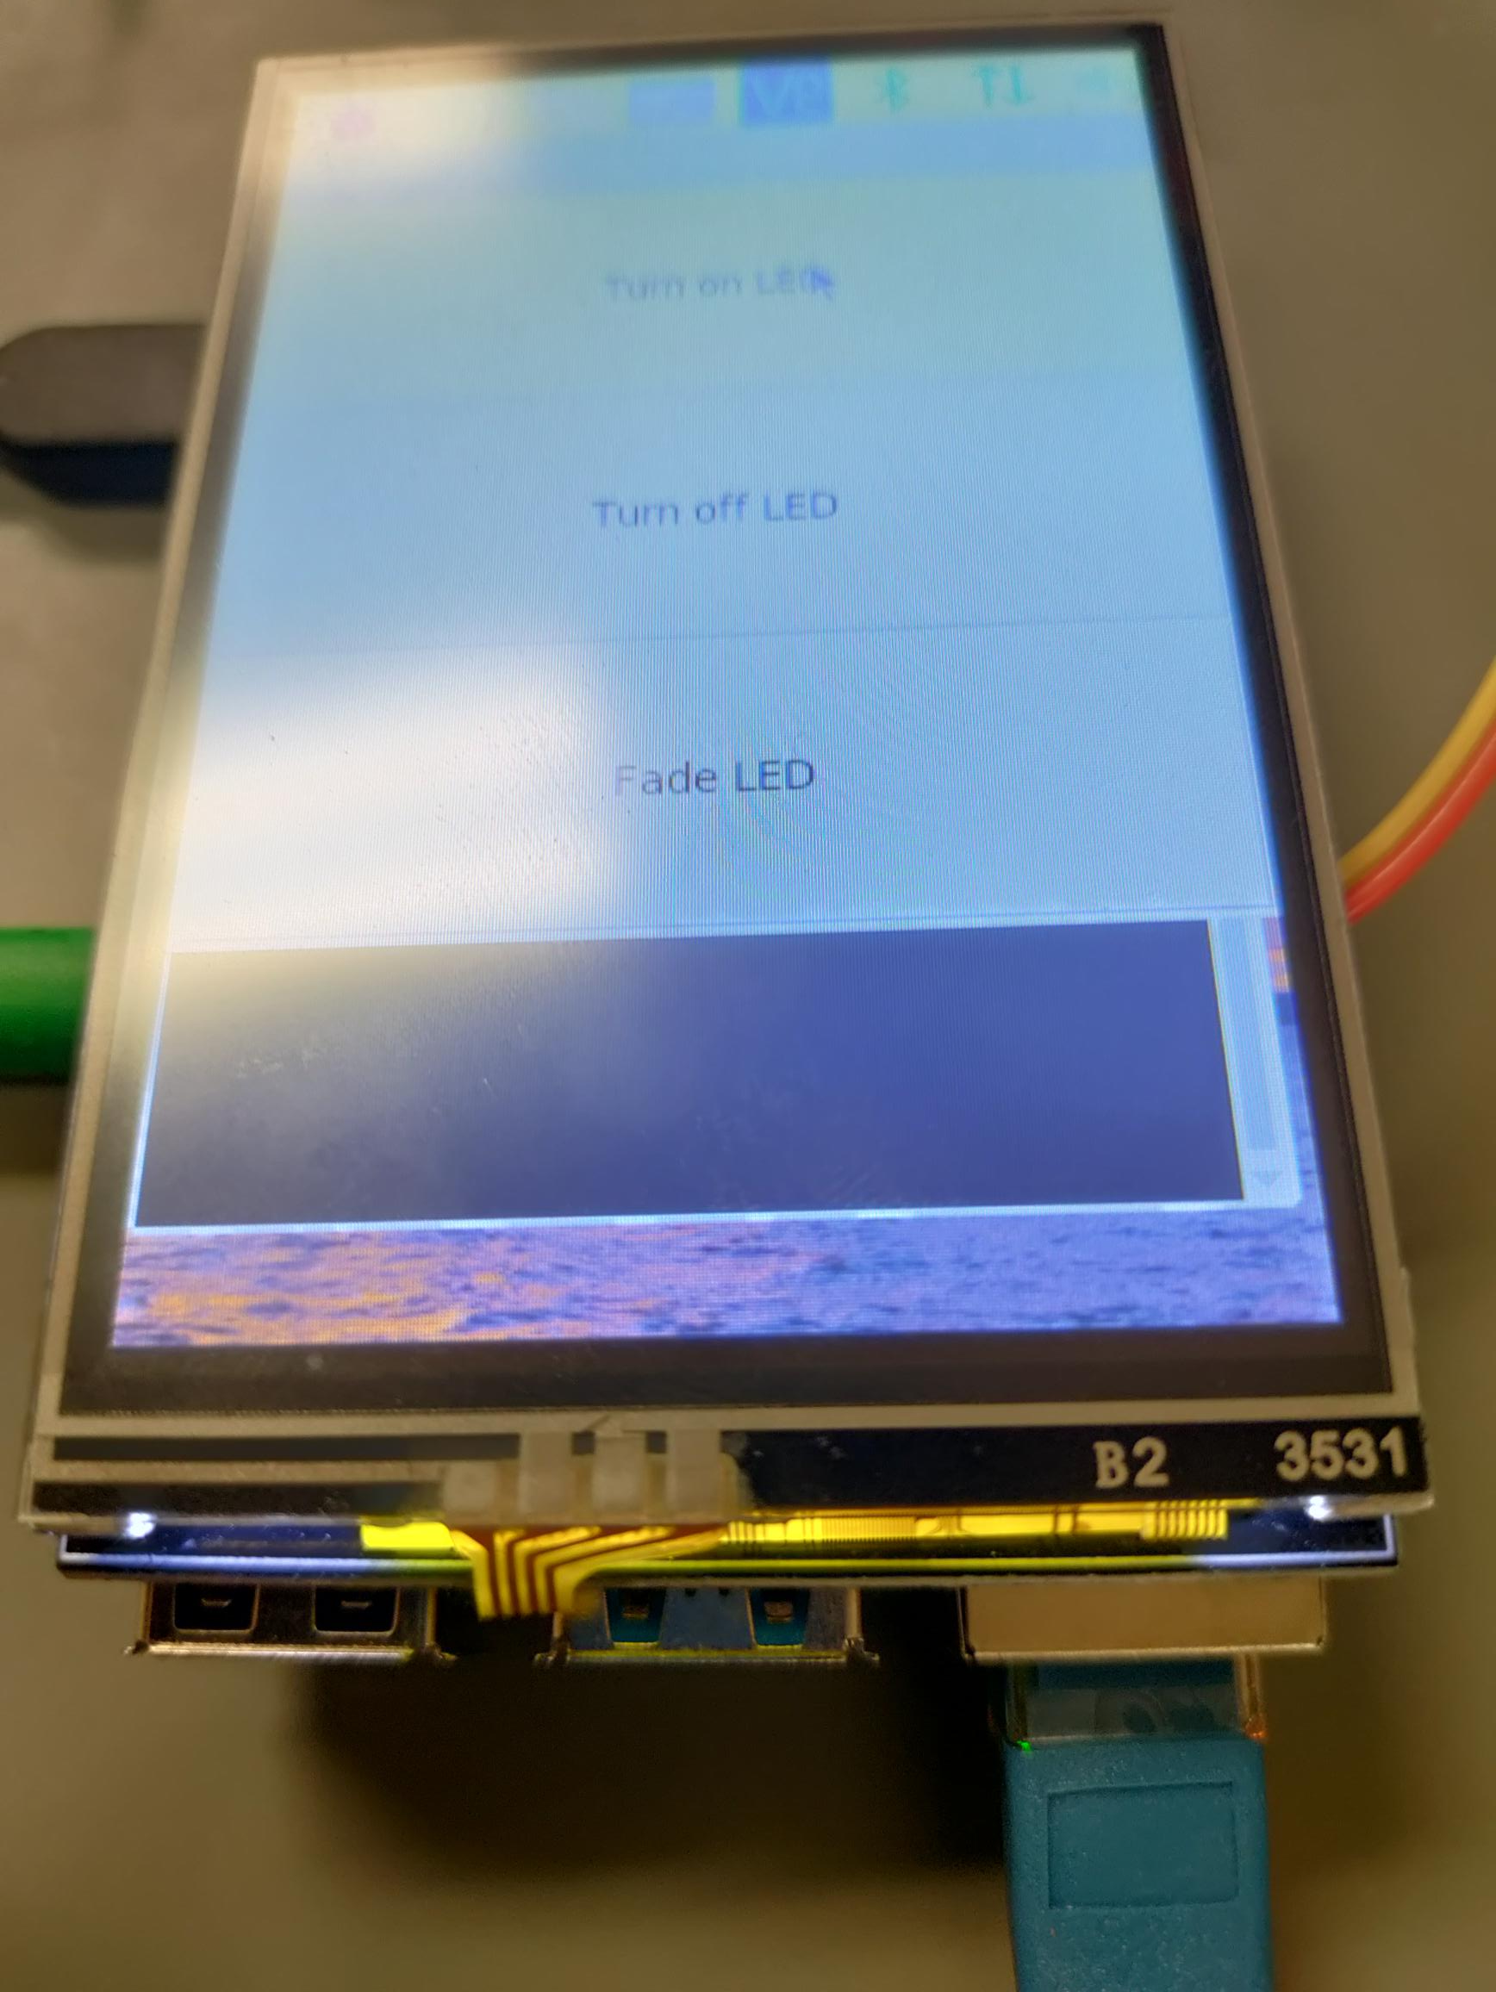
Test your Touchscreen
If your touchscreen is not working…
I have found these touchscreens need a little help to work.
Press down on the 4 copper pads shown in the picture to get it to work.
I assume a good bezel on the display would fix this issue.
Press here

Slide 21
From here
You could resize the button to take up all the space.
Create an exit button
root.attributes('-fullscreen', True) #would put the lcd.py into full screen mode
I highly recommend the YouTube series on Tkinter by “The New Boston”. https://www.youtube.com/watch?v=RJB1Ek2Ko_Y&list=PL6gx4Cwl9DGBwibXFtPtflztSNPGuIB_d

Slide 22
Let’s set the Pi back to the HDMI
Open the terminal window
cd LCD-show
sudo ./LCD-hdmi

